Slide 1

HR Analysis

Slide 2
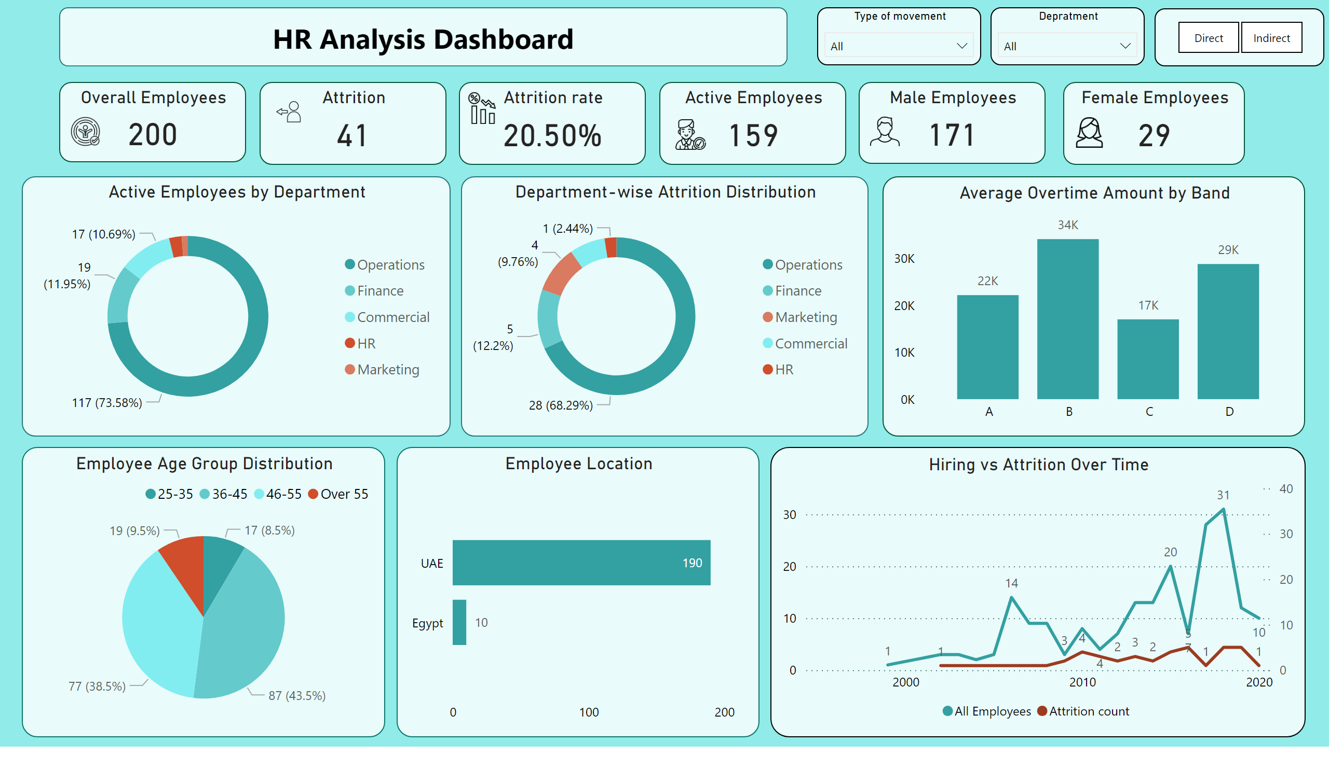
Drill Down Dashboard
Notes:
image
No alt text provided
Female Employees
No alt text provided
image
No alt text provided
Male Employees
No alt text provided
Department-wise Attrition Distribution
No alt text provided
Average Overtime Amount by Band
No alt text provided
slicer
No alt text provided
Employee Age Group Distribution
No alt text provided
image
No alt text provided
Active Employees
No alt text provided
image
No alt text provided
Attrition
No alt text provided
image
No alt text provided
Overall Employees
No alt text provided
Type of movement
No alt text provided
Active Employees by Department
No alt text provided
Hiring vs Attrition Over Time
No alt text provided
Depratment
No alt text provided
shape
No alt text provided
Employee Location
No alt text provided
image
No alt text provided
Attrition rate
No alt text provided

Slide 3
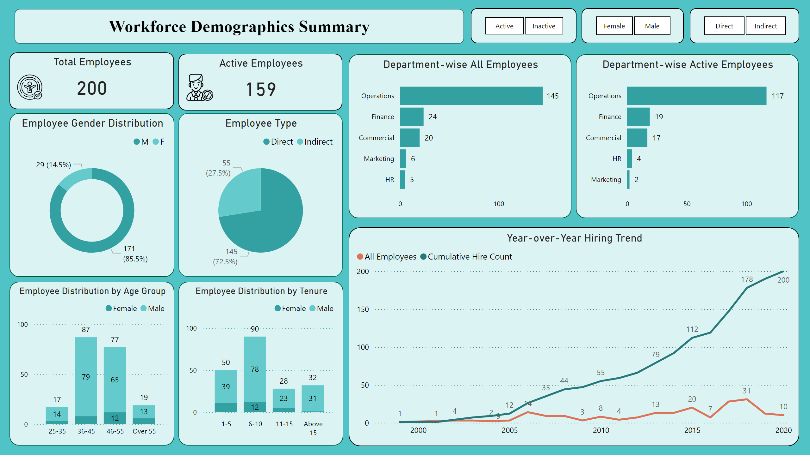
Demographics
Notes:
Department-wise All Employees
No alt text provided
Employee Distribution by Age Group
No alt text provided
slicer
No alt text provided
Employee Type
No alt text provided
image
No alt text provided
Active Employees
No alt text provided
image
No alt text provided
Total Employees
No alt text provided
Employee Gender Distribution
No alt text provided
Empl;oyee status
No alt text provided
slicer
No alt text provided
Employee Distribution by Tenure
No alt text provided
Department-wise Active Employees
No alt text provided
Year-over-Year Hiring Trend
No alt text provided
Employee Demographics Overview
No alt text provided

Slide 4
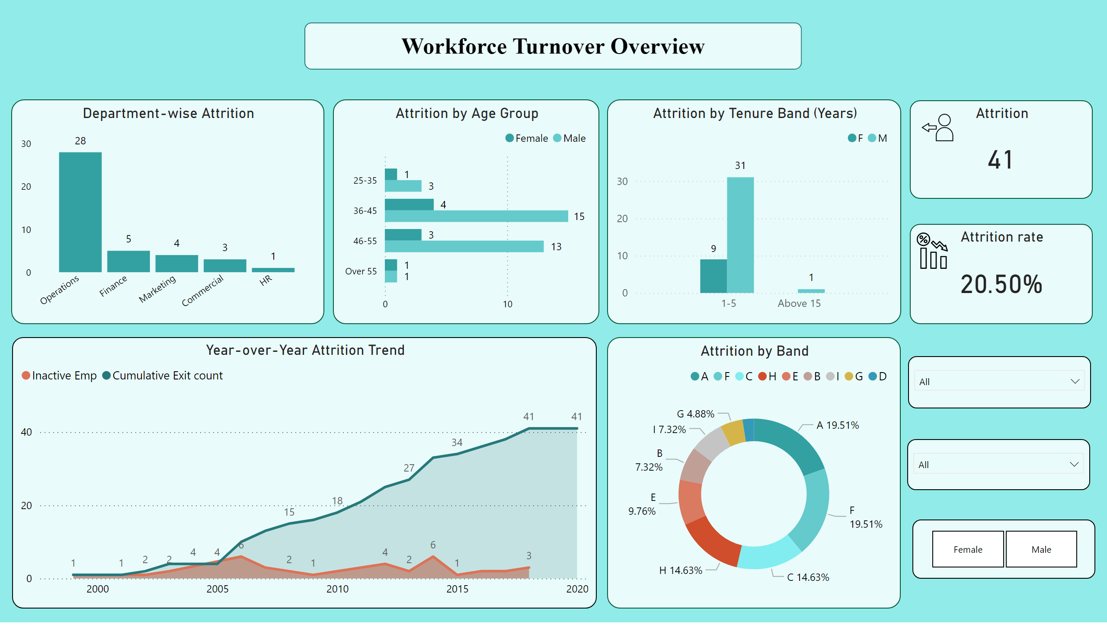
Turnover
Notes:
Attrition by Age Group
No alt text provided
slicer
No alt text provided
Attrition by Tenure Band (Years)
No alt text provided
Department-wise Attrition
No alt text provided
shape
No alt text provided
image
No alt text provided
Attrition
No alt text provided
image
No alt text provided
Attrition rate
No alt text provided
Attrition by Band
No alt text provided
Year-over-Year Attrition Trend
No alt text provided
slicer
No alt text provided
slicer
No alt text provided

Slide 5
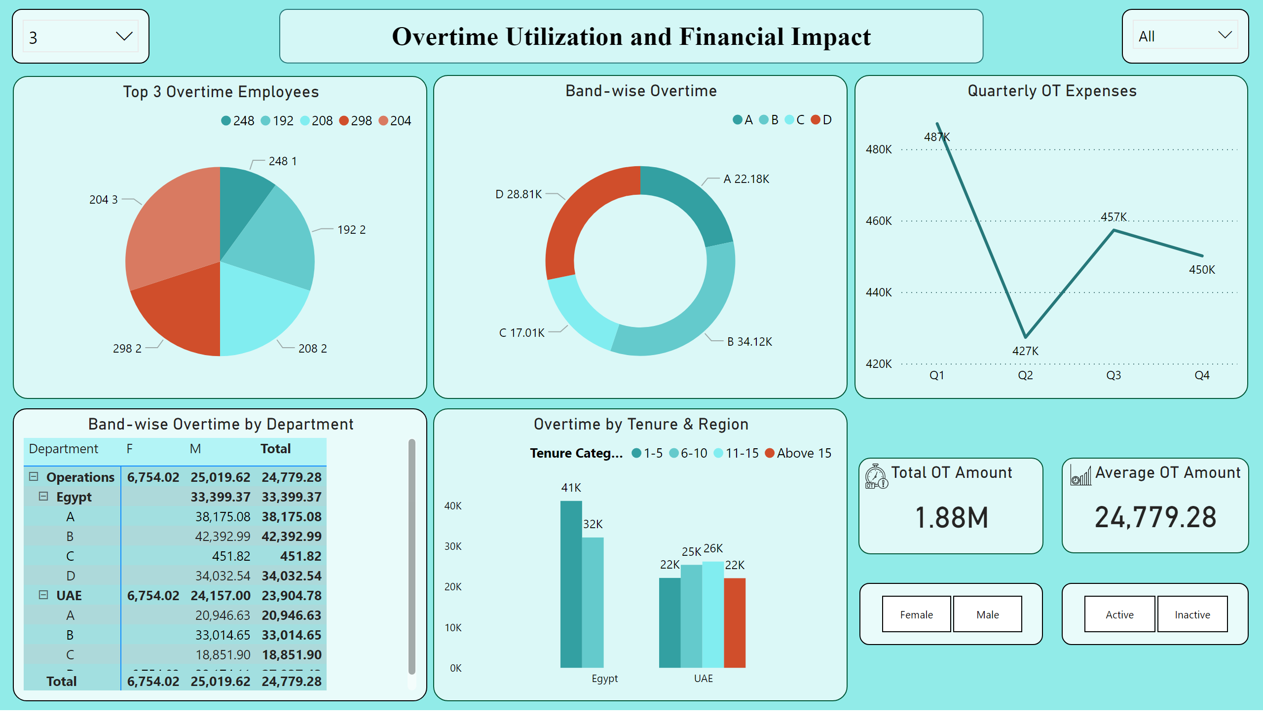
Over Time
Notes:
Band-wise Overtime
No alt text provided
Overtime by Tenure & Region
No alt text provided
shape
No alt text provided
image
No alt text provided
Total OT Amount
No alt text provided
image
No alt text provided
Average OT Amount
No alt text provided
Band-wise Overtime by Department
No alt text provided
slicer
No alt text provided
slicer
No alt text provided
Top 3 Overtime Employees
No alt text provided
Topn Filter
No alt text provided
slicer
No alt text provided
Quarterly OT Expenses
No alt text provided

Slide 6
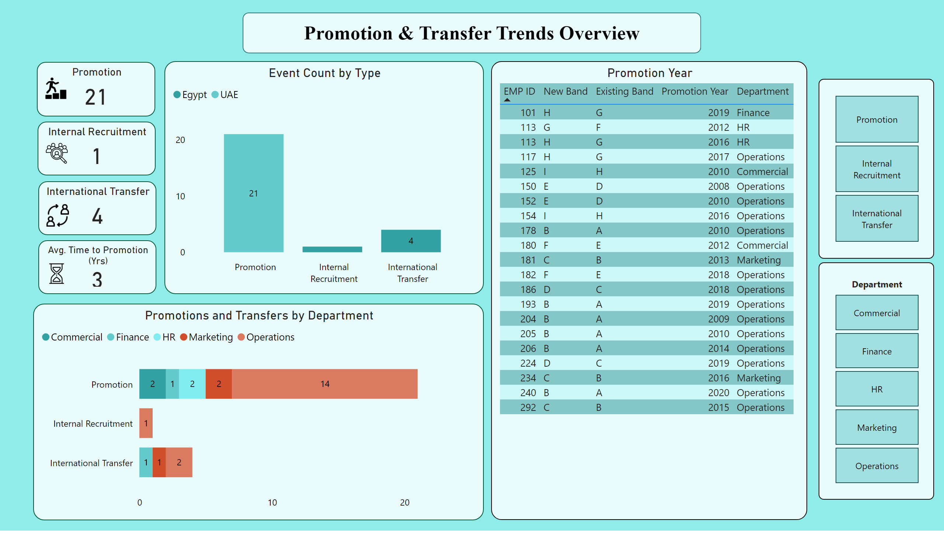
Promotion & Transfer
Notes:
shape
No alt text provided
image
No alt text provided
Promotion
No alt text provided
Promotions and Transfers by Department
No alt text provided
Event Count by Type
No alt text provided
slicer
No alt text provided
Promotion Year
No alt text provided
Department
No alt text provided
image
No alt text provided
International Transfer
No alt text provided
image
No alt text provided
Internal Recruitment
No alt text provided
image
No alt text provided
Avg. Time to Promotion (Yrs)
No alt text provided

